Slide 1
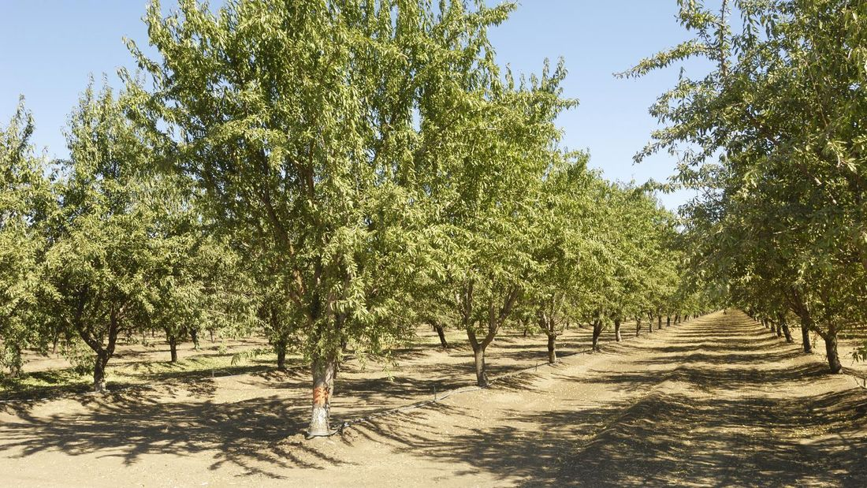

Predicting Almond Yield Kimberly Adams and Stephanie Benavidez
https://www.bunnings.co.nz/diy-advice/garden/planting-and-growing/how-to-grow-an-almond-tree
Notes:
Stephanie first
Kim next
Kim intros project
- predicting almond crop yield and if farmers should continue to plant almonds in the future

Slide 2
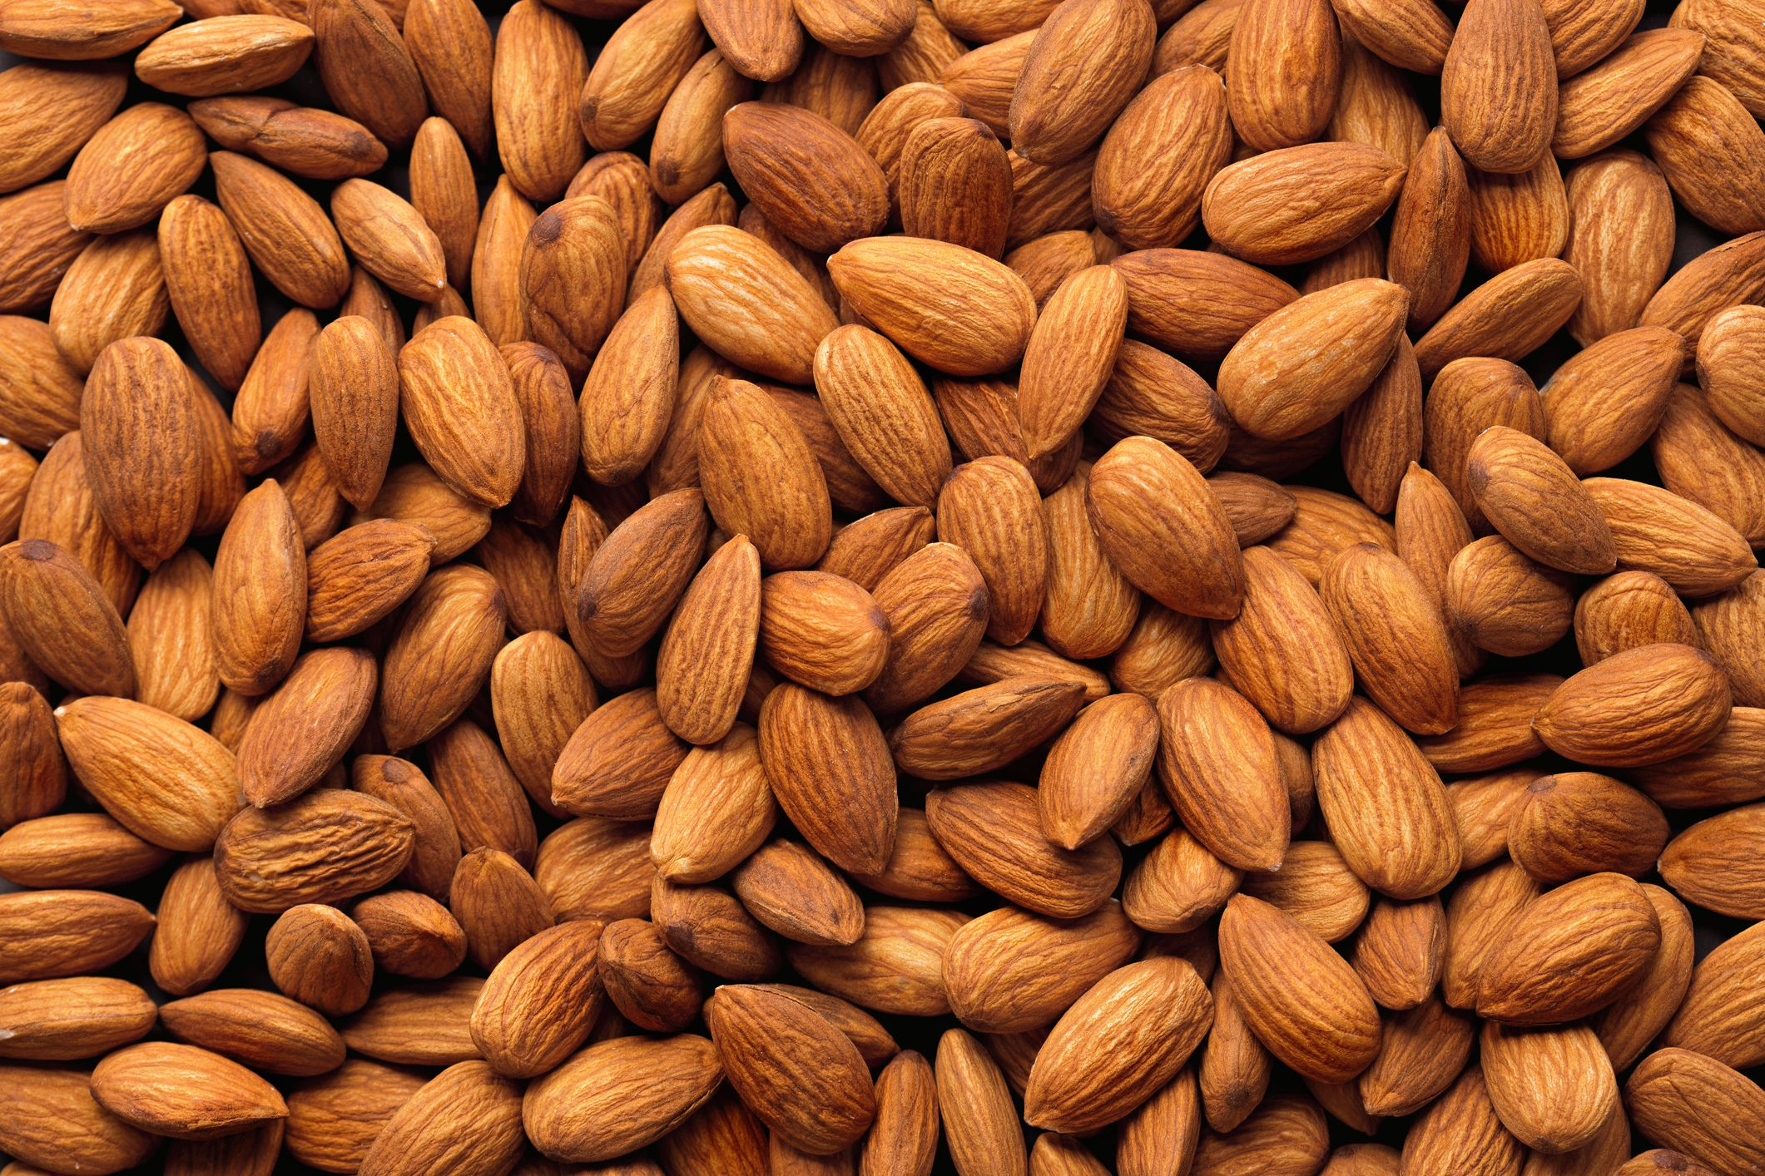
Almonds
Multiple nutritional benefits
Industry generates over $21 billion in revenue each year
Supports over 104,000 jobs in California alone
California produces roughly 80% of the world's supply
91% of farms are family owned
https://www.goodhousekeeping.com/health/diet-nutrition/a19503705/almonds-nutrition/
Notes:
KIM
Nutritional benefits:
- Protein
- Can create lactose-free milk, useful for allergies
- also gluten free
- Lowers blood pressure, cholesterol, blood sugar levels
Family owned
- less financial cushion
- more prone to difficulties if bad crop

Slide 3
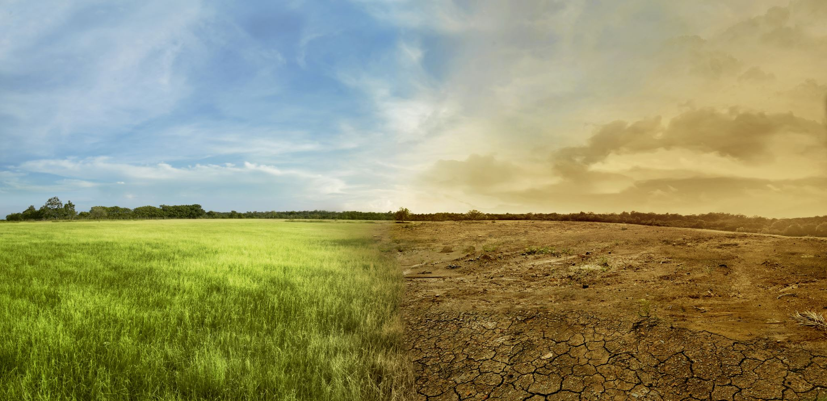
Shifting Climate
Multiple aspects are changing, for example:
Temperature
Rainfall
Frequency and severity of extreme weather events
Potential impacts to the agricultural growing season
Notes:
KIM
Dramatic shifts in climate
Temperatures are getting hotter
- heat advisories around the country
Rainfall
- flooding in some areas while dry in others
- less predictable
Severe weather
- more extreme
- tornadoes
- more intense and more frequent thunderstorms, tropical storms, and hurricanes
Impacts
- unpredictable water (either too little or too much)
- growing season shifts earlier or later
- growing season length changes
- impacts productivity and crop yeild

Slide 4

Project Questions
Are temperatures showing a positive trend supportive of global warming patterns?
Are crop yields decreasing or increasing over time?
Are there signs that increased costs (i.e., water, fertilizers, pesticides, transportation) have cut into profit margins over time?
If I am a farmer, is it still worth planting almonds next year?
Notes:
STEPHANIE
(read slide)

Slide 5

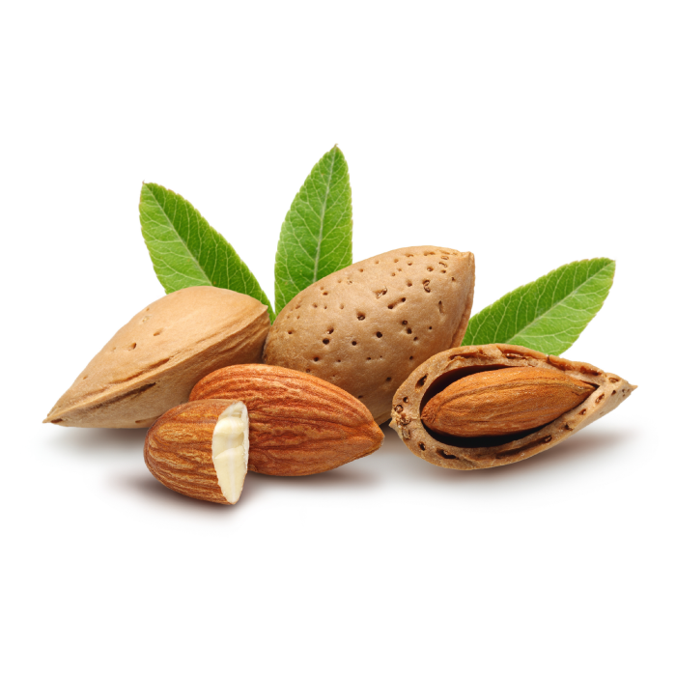
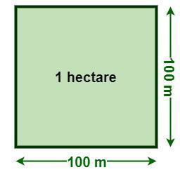



Data
Food and Agriculture Organization (FAO) of the United Nations
Collects measures of important markers of food production, needs, and costs as well as the population characteristics of different countries.
Crop Yield Almonds produced per hectare | Area Harvested Number of hectares harvested | Temperature Change Degrees difference from previous year
Producer Price Amount growers get at crop sale | Exports & Imports Yearly total value of exported and amount of imported crop | Level of Water Stress Proportion of water withdrawn from available sources
Notes:
STEPHANIE
Almonds in shell for United States
What is the FAO (read off slide)
FAO goals:
- improve nutrition
- increase agricultural productivity
- raise living standards in rural populations
- contribute to global economic growth
Go through the variables (read off what they are)

Slide 6
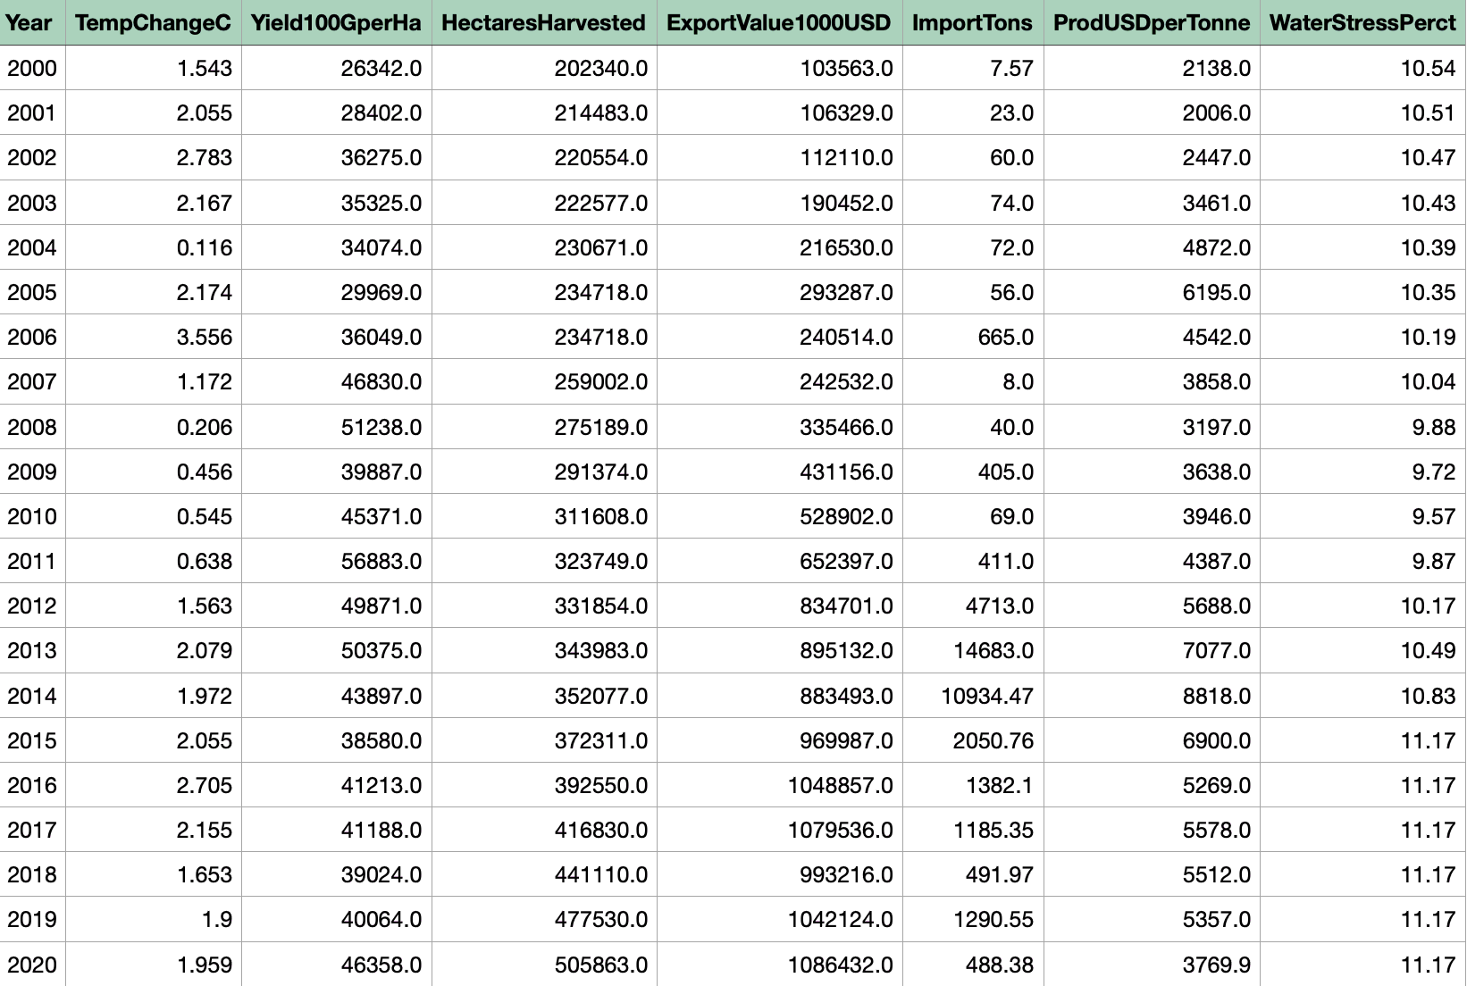
Data Cleanup
Extraction from source
Dropped unnecessary columns
Subsets
Minimal missing values*
Renamed columns
Checked datatypes
Set One | Set Two | Set Three
1961 - 2021 | 1991 - 2021 | 2000 - 2020
All variables except: Producer price Water stress | All variables except: Water stress | All variables
Notes:
KIM
Data was in different datasets
- extracting the desired columns (year and value)
- ignored the rest of the columns because they were more documentational than data
ex. country, units, what was being recorded)
- renamed the column we kept with descriptive name and units combined in one column heading
ex. ExportValue1000USD
Combined into one master data file
Checked to make sure numerical data was indeed numerical
Missing values
- dropped 2022 = only one value
- some variables had different ranges of data collection
variables not missing, but limiting timeframe
Subsets
- accounts for differing timeframes
- read slide for years and what is in each

Slide 7

Data Exploration
Box plots
Correlation matrixes
Line graphs
Notes:
STEPHANIE
As part of our data exploration we did the following (read slide)
We found line graphs to be the most informative (go to next slide)

Slide 8
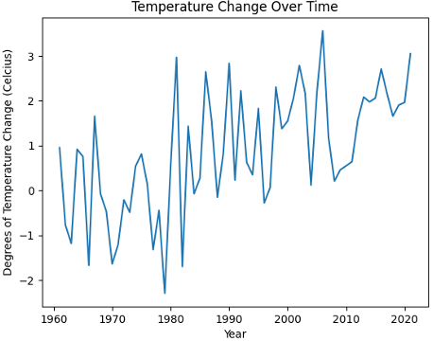
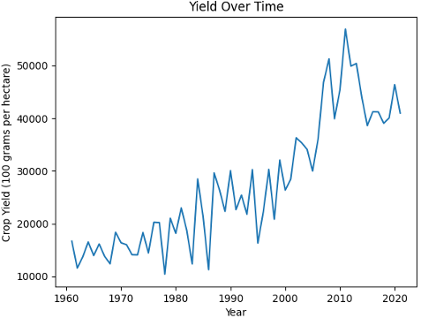
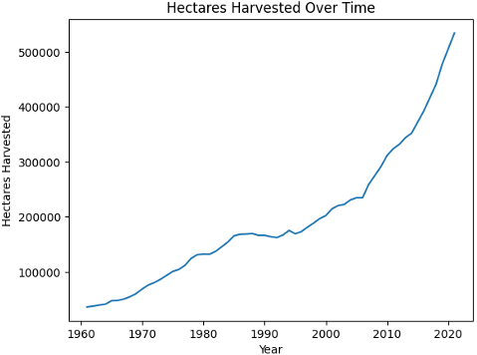
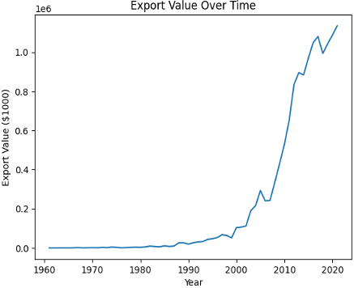
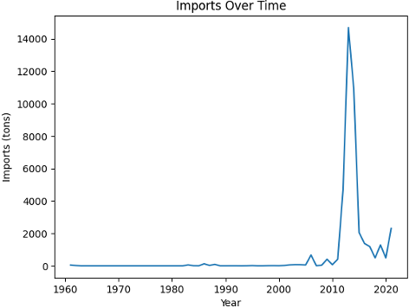
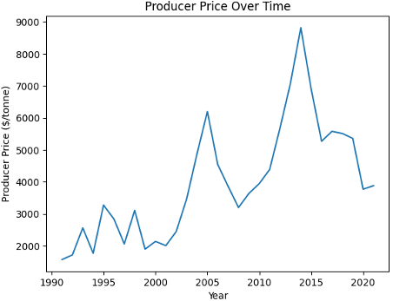
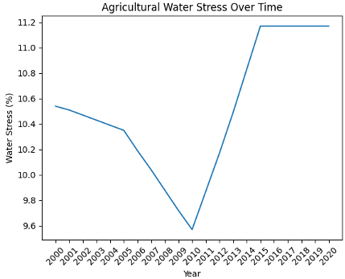
Line Graphs
Notes:
KIM
All variables showed overall increasing trend over time
Some variables had more fluctuations over time while others like Hectares Harvested showed smooth increases.
Note differing start years (last two)
- 1960 - Set One
- 1990 - Set Two
- 2000 - Set Three
Imports showed a huge spike around 2013-2014
- corresponds with a peak in producer price = suggests almonds were in hot demand during that time frame
- possible slight decrease in yield around same time = almonds slightly more scarce than before = driving up market value.
Water stress dropped (Set Three)
- too short of time frame
- little variability in values
- no marked trend

Slide 9
Preparing the data for modeling
Split each subset into training / test data sets
Train-Test Split for Set One (1961 - 2021, 60 years)
Train 1961 – 2010, 50 years
Test 2011 – 2021, 10 years
Train-Test Split for Set Two (1991 - 2021, 30 years).
Train 1991 – 2015, 25 years
Test 2016 – 2021, 5 years
Notes:
STEPHANIE
5/6 of data used to train the model on each subset
1/6 of data = data to test model prediction accuracy
Example:
In Set Two, out of the total 30 years, 25 years was used to train and 5 years to test predictions

Slide 10
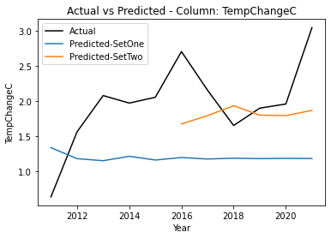
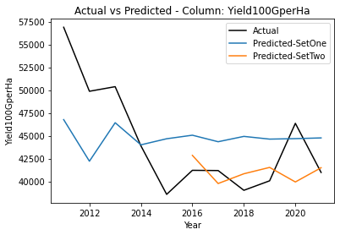
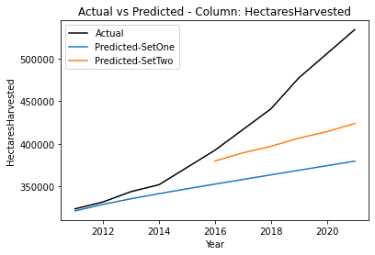
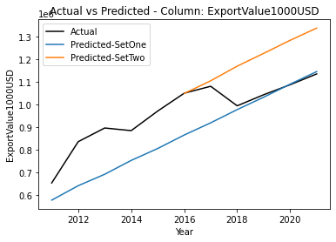
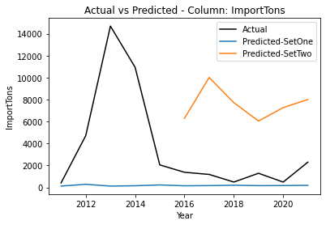
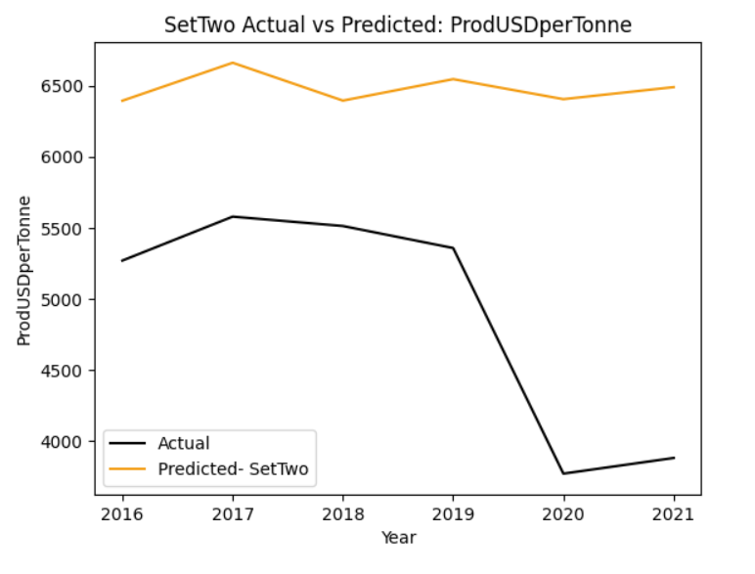
ARIMA Modeling
Notes:
KIM
ARIMA
- time series forecasting model
- handles seasonality and interdependence of time series data well
- auto-calculated model input parameters
Models used to create predicted values
Compared to the actual values from the test data = shown in black
Model built off of Set One shown in Blue
Model built off of Set Two (shorter set) shown in orange
Last graph only has Set Two model due to limited timeframe
Overall not a great fit
- Most variables bounce around quite a bit while the models are trying to smooth out the values
- Even in Hectares Harvested which is smoother, the models fail to match the actual values
Visually Set Two looks like a better fit
maybe due to lower variability in the shorter timeframe?

Slide 11
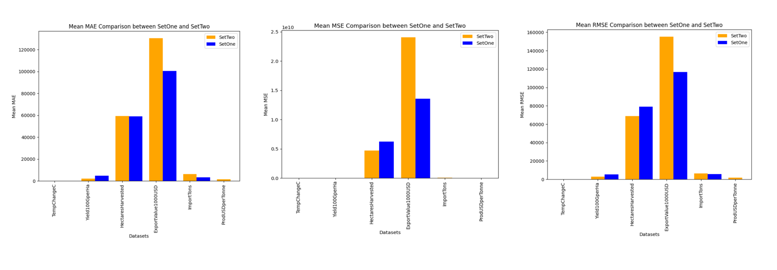
Metrics
Overall, the ARIMA model for Set One had lower error.
Export values consistently had the highest error rates.
Temperature change and yield had fairly low error rates.
Notes:
STEPHANIE
Comparison metrics for the two subsets
What does each graph indicate?
- Mean Absolute Error (MAE on left)
- Mean Squared Error (MSE in middle)
- Root Mean Squared Error (RSME on right)
Overall, the model for Set One had lower error than for Set Two
- Exports error was larger than the other variables
- Model for Set Two shows larger error value
Temperature and Yield show the lowest error rates within both models
- indicates model might be semi-decent at predicting these values

Slide 12
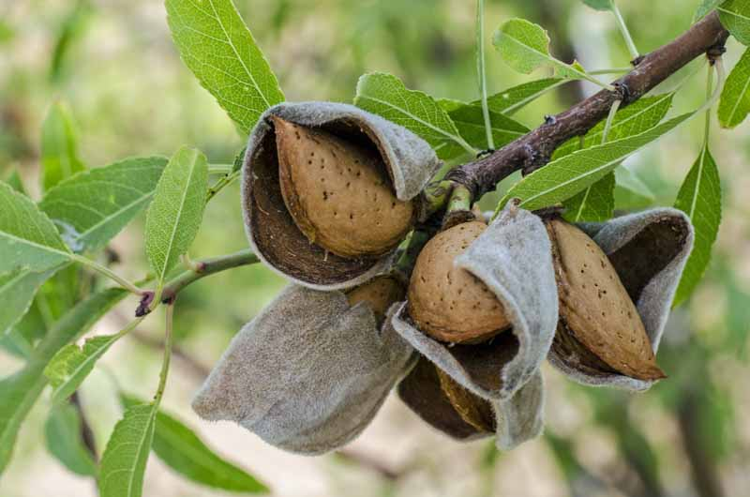
Model Conclusions
The ARIMA model for Set One had lower error than Set Two.
Most likely due to variation smoothing from the longer time frame.
None of the model predictions were remarkably accurate.
Best predictions were for temperature change and yield.
But…model sometimes overestimates the crop yield
Notes:
STEPHANIE
In conclusion... (read slide)

Slide 13

Answers to Original Questions
Are temperatures showing a positive trend supportive of global warming patterns?
Yes, temperatures show a positive trend over time within the data sources.
Are crop yields decreasing or increasing over time?
Crop yields are increasing both in the area harvested AND in the amount harvested per area unit.
Are there signs that increased costs (i.e., water, fertilizers, pesticides, transportation) have cut into profit margins over time?
Increasing value in exports, but also recent decreases in amount producer gets when selling suggesting lower profit margins.
If I am a farmer, is it still worth planting almonds next year?
Model suggests roughly same crop yield as past couple years, but cost increases may make it less feasible to turn a profit.
Notes:
KIM
(read slide)

Slide 14
Resources
California, A. B. (2016, June). California Almond Industry Facts. Retrieved from almonds.com: https://www.almonds.com/sites/default/files/2016_almond_industry_factsheet.pdf
Climate Change Indicators: Weather and Climate. (2022, August 1). Retrieved from www.epa.gov: https://www.epa.gov/climate-indicators/weather-climate
Crops and Livestock Products Data. (n.d.). Retrieved from www.fao.org: https://www.fao.org/faostat/en/#data/QCL
Food and Agriculture Organization. (2023). Retrieved from www.fao.org: https://www.fao.org/faostat/en/#data
Producer Price Trade Data - Crops and livestock products. (n.d.). Retrieved from www.fao.org: https://www.fao.org/faostat/en/#data/TCL
Producer Prices Data. (n.d.). Retrieved from www.fao.org: https://www.fao.org/faostat/en/#data/PP
SDG Indicators. (n.d.). Retrieved from www.fao.org: https://www.fao.org/faostat/en/#data/SDGB
Temperature Change on Land Data. (n.d.). Retrieved from www.fao.org: https://www.fao.org/faostat/en/#data/ET
Zelman, K. M. (2022, November 10). Health Benefits of Almonds. Retrieved from www.webmd.com: https://www.webmd.com/diet/health-benefits-almonds
Notes:
KIM
For more information and for links to our data sources, please see the links included on this slide.

